Slide 1
UNIT 5

Slide 2
What is Motion in Computer Vision?
In computer vision, a video is simply a sequence of images called frames.
For example:
If an object changes its position from one frame to another, we say that the object is moving.
Frame 1 Frame 2 Frame 3 Frame 4
👤 👤 👤 👤
left middle right further right

Slide 3
Computer vision tries to answer questions such as:
Is something moving?
Which direction is it moving?
How fast is it moving?
Which objects are moving?
What kind of movement is happening?
Is the person walking, running, sitting, or falling?

Slide 4
These questions lead to three related concepts:
Motion Estimation → "How did something move?"
Motion Analysis → "What does that movement tell us?"
Activity Recognition → "What activity is the person/object performing?"

Slide 5
Motion Estimation
Motion estimation is the process of finding the movement of objects or pixels between two or more video frames.
In simple words:
Motion estimation tells us where something moved and by how much.
Suppose we have two frames:

Slide 6
Frame 1 Frame 2
● ●
Object Object
↓ ↓
(x1,y1) (x2,y2)

Slide 7
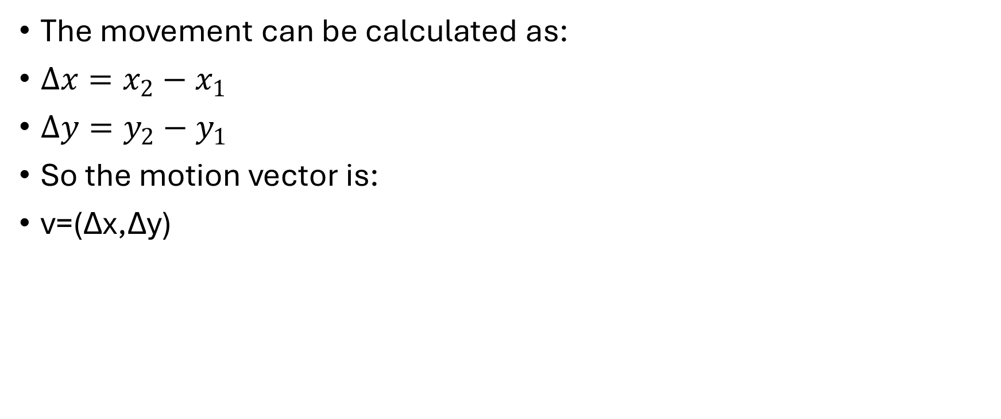
The movement can be calculated as:
$Δx=x_{2}−x_{1}$
$Δy=y_{2}−y_{1}$
So the motion vector is:
v=(Δx,Δy)

Slide 8
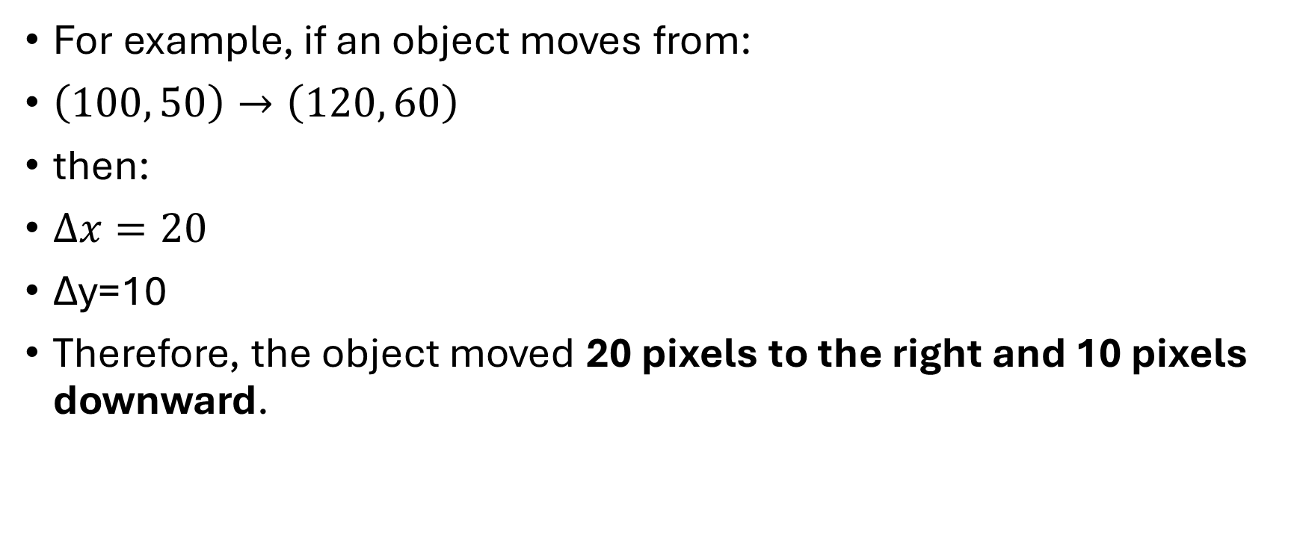
For example, if an object moves from:
$\left(100 , 50\right)→\left(120 , 60\right)$
then:
$Δx=20$
Δy=10
Therefore, the object moved 20 pixels to the right and 10 pixels downward.

Slide 9
Why Do We Need Motion Estimation?
Motion estimation is useful in many computer vision applications.
Examples
Video surveillance
Detect whether a person is entering an area.
Self-driving cars
Determine whether another car is moving toward or away from the vehicle.
Sports analysis
Track the movement of players and balls.
Gesture recognition

Slide 10
Understand hand movements.
Video compression
Instead of storing every frame completely, we can store the changes between frames.
Object tracking
Follow a person or vehicle across multiple frames.

Slide 11
Basic Idea Behind Motion Estimation
Suppose we have two frames in which one object is in left and other is in right.
The same object has moved.
The computer needs to determine:
What object/pixels correspond to each other?
Where did they move?
What is the direction?
What is the amount of movement?
This process is called motion estimation.

Slide 12
Motion Vector
A motion vector represents the movement of an object or image region.
It generally contains:
Direction
Magnitude (distance)

Slide 13
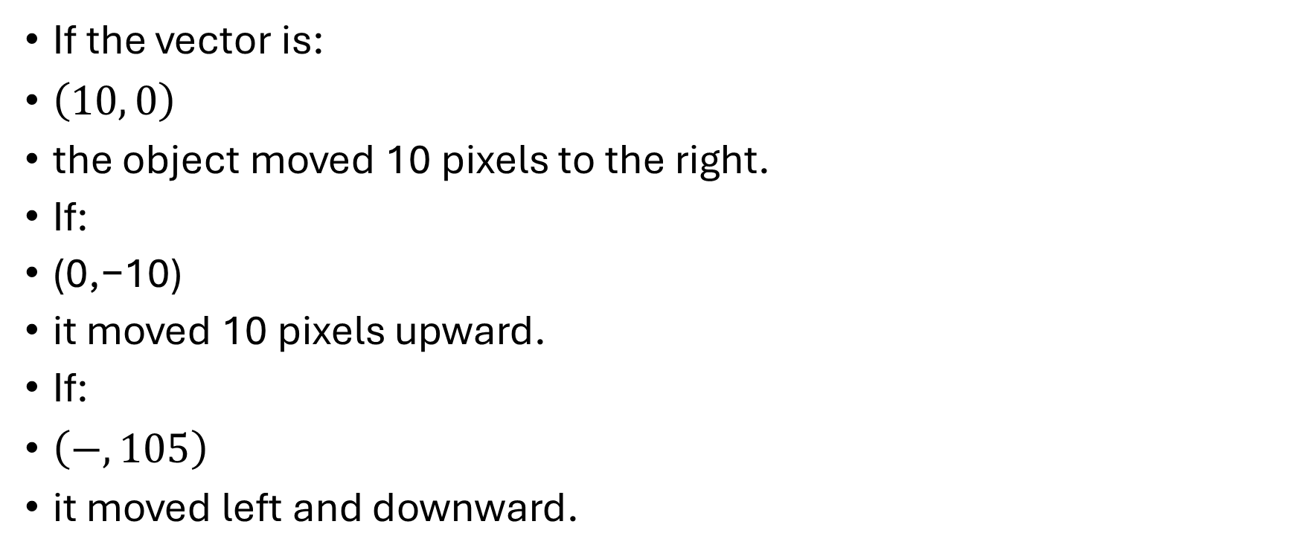
If the vector is:
$\left(10 , 0\right)$
the object moved 10 pixels to the right.
If:
(0,−10)
it moved 10 pixels upward.
If:
$\left(− , 105\right)$
it moved left and downward.

Slide 14
How Does the Computer Find Motion?
The computer compares different frames.
The computer asks:
"Where did the car go?"
It compares the two images and finds that the car appears at a different location.
This gives us the motion.

Slide 15
One Simple Method: Frame Difference
Compare two frames and look for what changed.
The changed pixels tell us that something moved.
Mathematically, we can think of:
Difference=Frame2​−Frame1​
Compare old frame and new frame → find differences → detect movement.
But There Is a Problem

Slide 16
Suppose the camera itself moves.
Imagine you record a road while walking:
Now almost everything in the image appears to move.
So the computer might think:
"Everything is moving!"
But actually:
The camera is moving.
This is an important problem in motion analysis.

Slide 17
Optical Flow
Imagine that you put a tiny arrow on every moving pixel.
These arrows describe how pixels appear to move between frames.
That collection of movement arrows is called optical flow.
→ → → → →
→ → → → →
→ → → → →

Slide 18
Imagine Rain
Here's an easy analogy.
Imagine you're looking through a window while rain is falling.
You see many drops moving:
You can describe the movement of all the drops using arrows.
Optical flow does something similar with image pixels.
Instead of rain drops:
We have pixels/features.

Slide 19
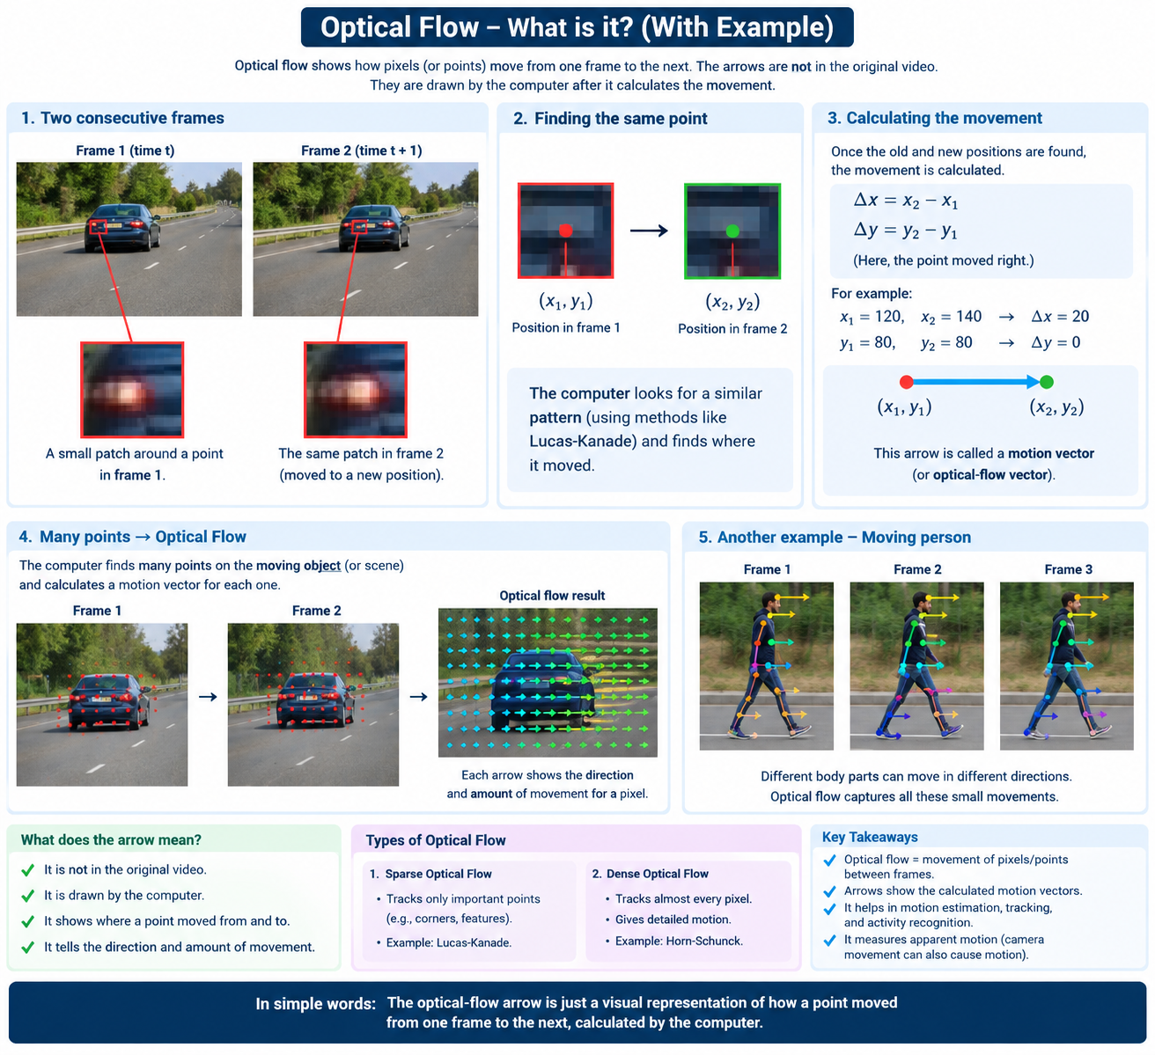

Slide 20
Start with pixel values
Calculate image gradients
Ix = change horizontally
Iy = change vertically ↓
Ix values:2,4,3
Iy values: 5,6,4
Build Matrix M

Slide 21
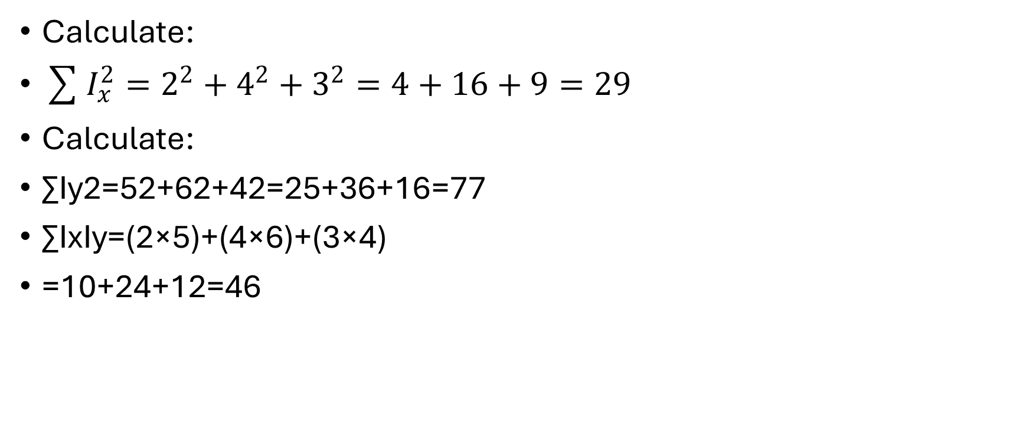
Calculate:
$\sum{I_{x}^{2}}=2^{2}+4^{2}+3^{2}=4+16+9=29$
Calculate:
∑Iy2​=52+62+42=25+36+16=77
∑Ix​Iy​=(2×5)+(4×6)+(3×4)
=10+24+12=46

Slide 22
M=[29 46
46 77 ]
Use the eigenvalue equation
We calculate:
∣M−λI∣=0
M−λI=[8−λ 6
​ 7 6- λ]

Slide 23
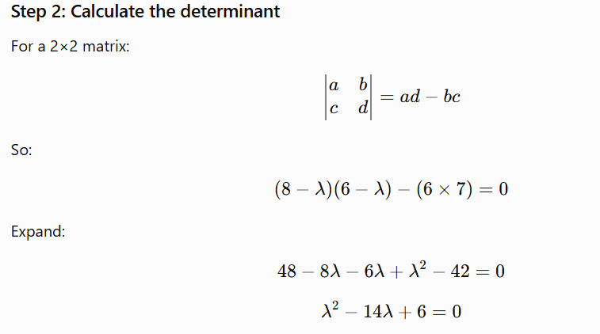

Slide 24
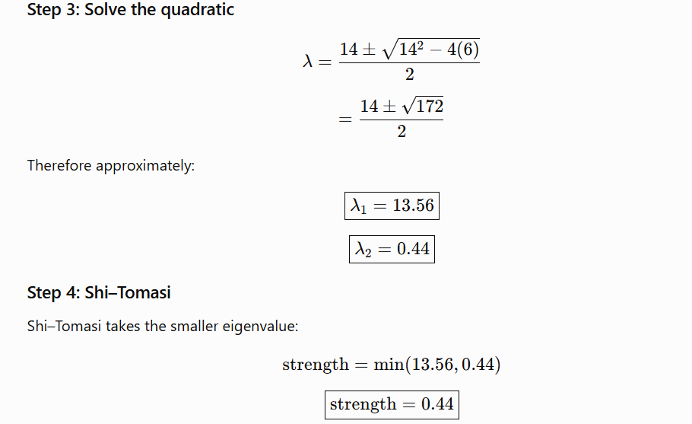

Slide 25
Now we get another picture from the camera.
We have:
old_frame frame
↓ ↓
previous current
Convert the new frame to grayscale
old_gray = previous image
gray = current image

Slide 26
Find where the points moved
old_gray — previous frame in grayscale.
gray — current frame in grayscale.
points — points/features detected in the previous frame that you want to track.
None — no initial estimate of where the points moved.

Slide 27
What it returns
new_points — estimated locations of the tracked points in the current frame.
status — tells whether each point was successfully tracked:
  1 → successfully tracked
  0 → tracking failed
error — error measure for each tracked point.

Slide 28
extracting the (x, y) coordinates of each old point and its tracked new position.
for new, old in zip(new_points, points):
x1, y1 = old.ravel()
x2, y2 = new.ravel()
Think of one tracked point:
OLD FRAME NEW FRAME
● ●
(100,50) ───────────→ (110,55)

Slide 29
zip() pairs corresponding points:
new_points points
↓ ↓
[110, 55] ↔ [100, 50]
[205, 82] ↔ [200, 80]
[295,125] ↔ [300,120]
So during the first loop:

Slide 30
new = [[110, 55]]
old = [[100, 50]]
x1, y1 = old.ravel()
old is usually shaped like:
[[100, 50]]
.ravel() converts it to:
[100, 50]

Slide 31
x2, y2 = new.ravel()
Similarly:
new = [[110, 55]]
becomes:
[110, 55]
Therefore:
x2 = 110

Slide 32
old point = (x1, y1) = (100, 50)
new point = (x2, y2) = (110, 55)
And you can calculate how much the point moved:
dx = x2 - x1
dy = y2 - y1
So the point moved 10 pixels right and 5 pixels down.

Slide 33
Background Subtraction
Suppose you have a video from a fixed camera:
Background = wall, floor, table, etc.
Moving object = person, car, ball, etc.
Learn what the background looks like, then find the parts that are different from the background.
Those different parts are usually the moving objects.

Slide 34
Original video:
Person + Road + Trees
After background subtraction:
Person → WHITE
Road + Trees → BLACK
So, the white region tells us where motion is happening.

Slide 35
the important thing is to understand how MOG2 decides “stable” vs “moving.”
MOG2 stands for Mixture of Gaussians 2.
In OpenCV, it is a background subtraction algorithm used to detect moving/foreground objects in videos.
MOG2 watches the video over time
Suppose the camera sees this:

Slide 36
Frame 1: 🪑 🚶
Frame 2: 🪑 🚶
Frame 3: 🪑 🚶
Frame 4: 🪑 🚶
The chair 🪑 stays in almost the same place in many frames.
The person 🚶 keeps changing position.
"This pixel/location normally looks like this → probably BACKGROUND."

Slide 37
"This location suddenly looks different → probably FOREGROUND.“
More technically
For each pixel/location, MOG2 keeps a statistical model of what values it normally sees.
For example, imagine pixel (100, 100) normally has:
Frame 1 → gray value 150
Frame 2 → gray value 151
Frame 3 → gray value 149
Frame 4 → gray value 150

Slide 38
MOG2 thinks:
"This pixel is consistently around 150. It's probably background."
But if suddenly:
Frame 5 → gray value 40
MOG2 thinks:
"That's very different from what I normally see → foreground."

Slide 39
What happens when the person stops?
If the person stands completely still for a long time, MOG2 can eventually learn that person's pixels as part of the background.
So it's not simply:
"White = object forever."
Instead, it continuously updates its background model.
WHITE = detected foreground/change
BLACK = background
White means foreground, the pixels that changed.
Black means background, the pixels that match what MOG2 learned.

Slide 40
MOG2 is an OpenCV method for background subtraction.
It tries to learn:
"What is normally present in the background?"
For example, imagine the camera sees:
Wall
Floor
Table
Person
The algorithm learns the stable parts:
Wall
Floor
Table

Slide 41
These become the background.
If a person moves through the scene, the person is treated as foreground.
Current Frame - Background = Moving Object
It's not literally doing a simple pixel subtraction like frame difference; MOG2 builds a statistical model of the background.

Slide 42
Simple frame difference compares two frames and marks pixels that changed by more than a fixed amount. It has no memory. A curtain swaying, a light flicker or camera noise all look like "motion", and a person who stands still disappears.

Slide 43
MOG2 keeps a memory of what each pixel usually looks like. For every pixel, it learns a range of normal values over many past frames instead of storing one fixed colour. Think of a pixel on the wall. Most of the time it's light grey, with small changes from noise and lighting. MOG2 learns "this pixel is normally around this grey, give or take a bit". The "Mixture of Gaussians" part means each pixel can hold several of these normal ranges. A pixel by a window can learn both "sunny" and "cloudy" as normal, and a tree leaf can learn "leaf" and "sky behind the leaf".

Slide 44
For each new frame, MOG2 asks every pixel whether its value fits one of the normal ranges it has learned. If it fits, the pixel is background. If it doesn't, the pixel is foreground. In the bedroom, the person walking in changes pixels to colours they've never had, so they are flagged.
MOG2 also keeps updating its model, so slow changes like gradual lighting get absorbed into the background. Someone who stops moving for long enough slowly becomes part of the background too. On top of that, it can spot shadows, which are darker but the same colour, and mark them separately.

Slide 45
In short, frame difference asks "did this pixel change from the last frame?", while MOG2 asks "is this pixel behaving differently from how it normally behaves?"

Slide 46
Contour Based
subtractor = cv2.createBackgroundSubtractorMOG2(
history=200,
varThreshold=40,
detectShadows=True
)
This is the main motion-detection algorithm.

Slide 47
history=200
MOG2 looks at previous frames to learn the background.
means MOG2 uses up to about 200 previous frames to learn/update its background model.
MOG2 can use a history of about 50 frames for its background model.
0 sec → Frame 1
1 sec → Frame 30
1.7 sec → Frame 50
2 sec → Frame 60

Slide 48
It means how much real time 50 video frames represent.
A video with 30 FPS means:
30 frames are shown every 1 second.
So:
30 frames → 1 second
50 frames → ? seconds
Calculate:
50 ÷ 30 = 1.67 seconds
So 50 frames are approximately 1.7 seconds of video.

Slide 49
So things that remain stable for a long time are learned as background.
varThreshold=40
This controls how much a pixel needs to change before MOG2 considers it foreground.
Lower → detects more small changes
Higher → ignores more small changes
A kernel is a small structuring element used for morphological image processing. Here, we create a 5×5 elliptical kernel to remove noise and clean the foreground mask.

Slide 50
MOG2 also tries to identify shadows.
White → foreground
Gray → shadow
Black → background
Create a kernel
kernel = cv2.getStructuringElement(
cv2.MORPH_ELLIPSE,
(5, 5)
)

Slide 51
This creates a small shape used for cleaning the mask.
v2.getStructuringElement()
This function creates a kernel (also called a structuring element).
A kernel is basically a small matrix/shape that OpenCV moves over the image to perform operations like:
removing noise
filling gaps
connecting nearby regions
making objects thicker

Slide 52
cv2.MORPH_ELLIPSE
This tells OpenCV:
"Make the kernel elliptical/rounded."
For a (5,5) kernel, you can roughly imagine:
It is not a square; it has a rounded shape.
Why use an ellipse?
Because motion/object regions usually have irregular, rounded boundaries, and an elliptical kernel can clean them without making corners as aggressively as a square kernel.

Slide 53
(3, 3) → small effect
(5, 5) → medium effect
(9, 9) → stronger effect
Because ellipse is smoother/rounded, so it is usually better for cleaning irregular object shapes in a motion mask.

Slide 54
Read a frame
Apply MOG2
Remove shadows (I only want pure white foreground.)
0–199 → BLACK 200–255 → WHITE
B lack = background White = detected foreground
The gray shadow pixels are removed because gray values are generally below 200.

Slide 55
Remove small noise
mask = cv2.morphologyEx( mask, cv2.MORPH_OPEN, kernel )
Dilate the object
mask = cv2.dilate(mask, kernel, iterations=2)
Find contours
Ignore tiny contours
if cv2.contourArea(c) < 500: continue

Slide 56
Find the rectangle
Draw green rectangle

Slide 57
Centroid Tracking
Imagine you have a video of a person walking in a room.
Our computer wants to answer:
“Where is the person, and where is the person moving?”
To do this, we use several steps:
Video → Background Subtraction → Mask → Contours → Centroid → Track Movement

Slide 58
First, we have a video
For example: The person is moving from left to right.
But the computer doesn't understand:
"Oh, that's a person."
It only sees pixels.
So we need image-processing techniques to find the moving object.

Slide 59
A centroid is simply the center point of an object.
We calculate it using image moments:
M = cv2.moments(c)
cv2.moments() calculates mathematical moments of a contour, which can be used to find properties such as the area and centroid of the detected object.
mathematical measurements that describe a detected object's shape and position

Slide 60
m00 → related to area
m10 → helps find X position
m01 → helps find Y position
Suppose object has 3 pixels at:
(1,1) (2,1) (3,1)
m00 represents the amount/area of the object.
There are 3 pixels:
m00 = 3

Slide 61
For m10, we consider the x-position of each pixel:
1 + 2 + 3 = 6
Find cx
cx = m10 / m00 cx = 6 / 3 cx = 2
So the center in the X direction is:
cx = 2
All three pixels have:
y = 1

Slide 62
m01 = 1 + 1 + 1 m01 = 3
cy = m01 / m00
cy = 3 / 3
cy = 1
Therefore:
Centroid = (cx, cy) = (2, 1)
m00 means the area/size of the detected object.

Slide 63
# Draw centroid
cv2.circle(frame, (cx, cy), 7, (0, 0, 255), -1)
The radius of the circle -> 7.
-1
means:
Fill the circle completely.
If we used:
2
the circle would only have a border with thickness 2.

Slide 64
Motion History Image
The basic idea is:
MHI keeps a short history of where motion happened.
Normal frame difference tells you:
"Where is motion happening RIGHT NOW?"
MHI tells you:
"Where has motion happened RECENTLY?"

Slide 65
White → motion happened very recently
Light gray → motion happened a little earlier
Dark gray → motion happened longer ago
Black → no recent motion
Recent motion → higher value → brighter
Old motion → lower value → darker
No motion → 0 → black

Slide 66
MHI is more like:
MHI:
White = recent motion
Gray = older motion
Black = no recent motion

Slide 67
mhi = np.zeros_like( prev_gray, dtype=np.float32 )
This creates an empty image with the same size as the video frame.
Initially:
MHI:
BLACK BLACK BLACK BLACK
BLACK BLACK BLACK BLACK
BLACK BLACK BLACK BLACK

Slide 68
Why?
Because we haven't detected any motion yet.
Think of mhi as an empty notebook.
As motion happens, we write information into it.
Set motion duration duration=1.0
This means:
Keep motion history for approximately 1 second.

Slide 69
Motion happened now ↓ Keep it visible ↓ For about 1 second ↓ Then remove it
you use:
duration = 2.0
motion stays visible for approximately 2 seconds.
absdiff means absolute difference.
It compares the pixels in the two frames.
For example:

Slide 70
Previous pixel = 100
Current pixel = 150
Difference = |100 - 150| = 50
If the pixel didn't change:
Previous = 100
Current = 100
Difference = 0

Slide 71
So:
No change → 0
Change → larger value
This is basically Frame Difference.
Now we convert the difference into a simple black-and-white motion image.
The important number is:
25
It means approximately:
If the pixel difference is greater than 25, consider it motion

Slide 72
Difference < 25 ↓ BLACK
Difference > 25 ↓ WHITE
he result might look like:
BLACK BLACK BLACK BLACK
BLACK BLACK WHITE BLACK
BLACK WHITE WHITE BLACK
BLACK BLACK BLACK BLACK
The white areas are where movement was detected.

Slide 73
Get the current time
This gives us the current time in seconds.
timestamp = (
cv2.getTickCount() /
cv2.getTickFrequency()
)

Slide 74
Why do we need time?
Because MHI needs to know:
When did this motion happen?
That's what allows it to show recent vs old motion.
Store the current motion
mhi[motion > 0] = timestamp
motion > 0
means:
Find all pixels where motion was detected.

Slide 75
hen:
mhi[...]
selects those positions in the MHI.
And:
= timestamp
records the current time there.

Slide 76
So if motion happens at:
t = 10 seconds
we store:
MHI pixel = 10
If motion happens later:
t = 11 seconds
we store:
MHI pixel = 11
So MHI remembers when motion happened.

Slide 77
Remove old motion
mhi[timestamp - mhi > duration] = 0
If the motion is older than our chosen duration, remove it.
Our duration = 1.0
Suppose:
Current time = 10 seconds
and a pixel contains:
mhi = 8 seconds
Then:
10 - 8 = 2 seconds
Motion is 2 seconds old.
Our allowed duration is only 1 second:

Slide 78
2 > 1
So we remove it:
mhi = 0
But if:
mhi = 9.5
then:
10 - 9.5 = 0.5
That motion is only 0.5 seconds old, so we keep it.

Slide 79
Kalman Filter
Suppose we detect the person's center in each frame:
Frame 1 → (100, 200)
Frame 2 → (110, 200)
Frame 3 → (120, 200)
We can see that the person is moving to the right.
Kalman Filter uses this information to estimate:
Frame 4 → probably (130, 200)

Slide 80
So its main job is:
Use the previous movement to predict where the object will be next.
Suppose a person is moving right:
Frame 1 Frame 2 Frame 3
● ● ●
100 110 120

Slide 81
Kalman notices that the position is changing:
100 → 110 → 120
So it estimates the velocity:
+10 pixels/frame
Then it uses that velocity to predict:
120 + 10 = 130
Actual: 100 → 110 → 120 ↓ Prediction: 130

Slide 82
Kalman keeps:
x = person's horizontal position
y = person's vertical position
vx = horizontal movement speed
vy = vertical movement speed
x = 120 y = 200 vx = 10 vy = 0

Slide 83
Person is at (120, 200) and moving 10 pixels right and 0 pixels up/down.
new x = old x + vx
Our example:
120 + 10 = 130
So predicted X = 130.

Slide 84
Row 2
[0, 1, 0, 1]
This tells Kalman:
new y = old y + vy
Our example:
200 + 0 = 200
So predicted Y = 200.

Slide 85
Row 3
[0, 0, 1, 0]
This says:
new vx = old vx
So:
10 → 10
For now, Kalman assumes the horizontal speed continues.

Slide 86
Row 4
[0, 0, 0, 1]
This says:
new vy = old vy
So:
0 → 0

Slide 87
What is CSRT?
SRT = Channel and Spatial Reliability Tracker.
CSRT is an object-tracking algorithm that follows one selected object from frame to frame.
You select the person only once.
CSRT then tries to find that same person in every next frame.
Why do we need CSRT?
Suppose your video has:

Slide 88
Person 1
Person 2
Car
Dog
If you use MOG2, it may detect several moving objects.
But maybe you only want to follow Person 1.
CSRT allows you to say:
"I want to track THIS object."
Then CSRT follows it.

Slide 89
Detection vs Tracking
Detection
"Where are the objects?"
Tracking
"I already selected this person.
Where is the SAME person in the next frame?"

Slide 90
Select the object
This is the most important part:
bbox = cv2.selectROI(
"Select Object",
frame,
False
)

Slide 91
ROI means:
Region Of Interest
It means:
"Select the part of the image that I am interested in."
A window appears.
You draw a rectangle around the person:
That rectangle becomes our bbox.
True → show crosshair (+)
False → don't show crosshair

Slide 92
What is bbox?
bbox means bounding box.
It contains:
x = horizontal position
y = vertical position
w = width
h = height

Slide 93
For example:
bbox = (100, 80, 60, 150)
x = 100 y = 80 width = 60 height = 150
Close the selection window
Create CSRT
tracker = cv2.TrackerCSRT_create()
This creates the CSRT tracker.

Slide 94
CSRT tracker ↓
"Okay, I'm ready. Tell me what object to track.“
At this point CSRT exists, but it doesn't know what object you want.
Give CSRT the object
racker.init(frame, bbox)
You're telling CSRT:
"This is the object I want you to track."

Slide 95
frame → which image?
bbox → which object?
Start reading the remaining frames
Success, bbox = tracker.update(frame)
"CSRT, look at this new frame and tell me where the object is now.“
Suppose:
Frame 1
You selected:
Person position = x=100

Slide 96
Frame 2
CSRT searches the new frame and finds:
Person position = x=110
Frame 3
It finds:
Person position = x=123
Frame 4
It finds:
Person position = x=137

Slide 97
So CSRT keeps updating the bounding box.
You select the person
First frame:
You are basically telling CSRT:
"This rectangle contains the object I want.“
CSRT looks at what's inside
It doesn't understand:
"Oh, this is a human being."
It doesn't necessarily know the concept of person.
Instead, it looks at visual patterns inside the selected area.

Slide 98
For example:
Person
├── edges
├── shapes
├── texture
├── color information
└── other visual patterns
Think of it as creating a kind of visual fingerprint of the selected region.

Slide 99
Next frame arrives
The person moves:
CSRT now asks:
"Where in this new frame does the visual pattern I learned appear?"
It searches around the expected area.
It finds the best match
Suppose it finds:

Slide 100
Then it says:
"I think this is the same object."
And moves the tracking box there.
SELECT ↓ Learn visual appearance ↓ New frame ↓ Search for similar appearance ↓ Find best match ↓ Move box ↓ New frame ↓ Search again

